Slide 1

SPOTIFY CLONE
Team No. : 8
Team Members and Roll No.
Kush – 2210990530
kushank Jain-2210990534
Lalitesh- 2210990539
Kartikay - 2210990491

Slide 2

I Introduction
We made the spotify clone where music meets innovation. Immerse yourself in a seamless audio experience as we replicate the magic of Spotify, offering a symphony of features that redefine how you groove. From personalized playlists to an extensive library, get ready to embark on a musical journey like never before. Explore, discover, and tune into the future of music streaming with our cutting-edge Spotify clone.

Slide 3

What is Spotify?
Spotify clone app is a music streaming app which provide a free plateform to listen music without downloading it.
The software is user-friendly from login to listening music. With the various features, users can enjoy listening to their favourite songs with ease.
Users will use the offline option to stream the album and listen without using the internet.
It is a freemium app also, some basic features are with adversting and limited control.

Slide 4

Objective
User Experience (UX) Design: Focus on creating a seamless and intuitive user experience. This includes designing user interfaces for different screens (desktop, mobile, tablet) that are visually appealing and easy to navigate.
Music Recommendations: Implement a recommendation system that suggests music based on the user's listening history, preferences, and behaviors. This can enhance user engagement and satisfaction.
Social Features: Incorporate social features such as following other users, sharing playlists, collaborative playlist creation, and seeing what friends are listening to. Social integration can enhance user engagement and retention.
Offline Mode: Implement offline mode functionality, allowing users to download songs or playlists for offline listening. This can enhance user convenience, especially for users with limited internet connectivity.

Slide 5
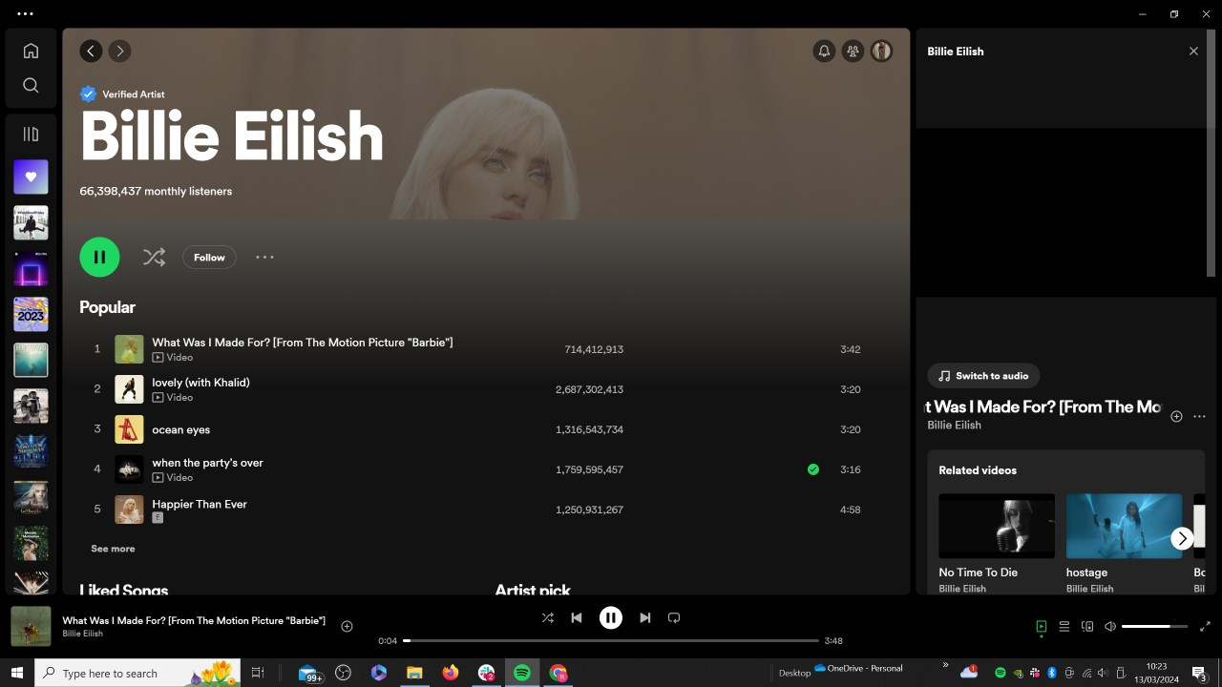
React
React is a JavaScript library for building user interfaces.
It is used to build single-page applications.
It allows us to create reusable UI components
Functions Used
useState:
openPreview
closePreview
generateRandomColor
handleCardClick
useEffect:
setInterval
clearInterval

Slide 6

Algorithm
HTML to React Components:
For each component such as header, navigation bar, search bar, etc. ,we have created corresponding React components.
01.
An algorithm involves various steps to ensure efficient functionality, user satisfaction, and business success.
By following these steps and incorporating relevant algorithms, the website can lead to increased engagement, loyalty, and revenue.
The steps are as follows:
Add Styling with CSS:
Apply styles to each React component to achieve the desired layout and appearance.
02.
Implement Interactive Features:
Addition of interactive features such as sliders, dropdown menus, date pickers, etc., using JavaScript
User interactions such as booking forms, reviews, ratings, etc.
03.
22CS016
​

Slide 7
Conclusion
In conclusion, the Music Player project stands as a testament to the synergy between HTML, CSS, and JavaScript, showcasing their collaborative power in creating a seamless and enjoyable audio playback experience. By combining intuitive design elements with interactive functionality, this project provides a solid foundation for further customization and expansion. Happy coding and happy listening!
That's it! I hope this "Music Player Using HTML, CSS and JavaScript" will assist you on your programming journey, providing value to your current and upcoming projects.

Slide 8
Reference
W3Schools - https://www.w3schools.com/
CSS-Tricks - https://css-tricks.com/
Codecademy -https://www.codecademy.com/

Slide 9


